Slide 1
ColorBlindAid
The initial idea was to create a selectively masked video for colorblind people to help the differentiate between colors they find hard to perceive.
However I was not able to achieve this , following ppt explains what the vision of project was.

Slide 2
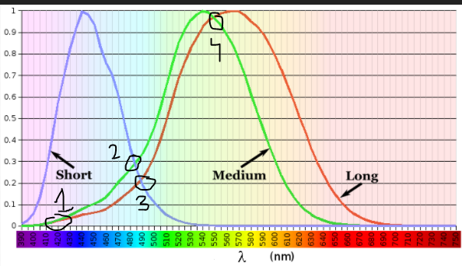
The main reason behind colorblindness is missing one or more cones from LMS curves.
The 4 points shown in the graph are the overlapping of L M S curves which are the wavelengths that colorblind people of different types find hard to interpret. So a simple solution can be cutting out these wavelengths in a image and shifting them to the closest color wavelength (left or right to the curve ) which can be identified by the user.

Slide 3
How these chunks of wavelengths are to be cut out depends on what type of colorblindess(protanopia , deuteranopia, tritanopia) and of what intensity the user has which I was not able to integrate in the code. The algorithm that I followed in the hard code was to LMS daltonization which I found in this report https://www.researchgate.net/publication/326626897_Smartphone_Based_Image_Color_Correction_for_Color_Blindness This worked perfectly for a single image given as input but using this for a video stream did not produce expected results.

Slide 4
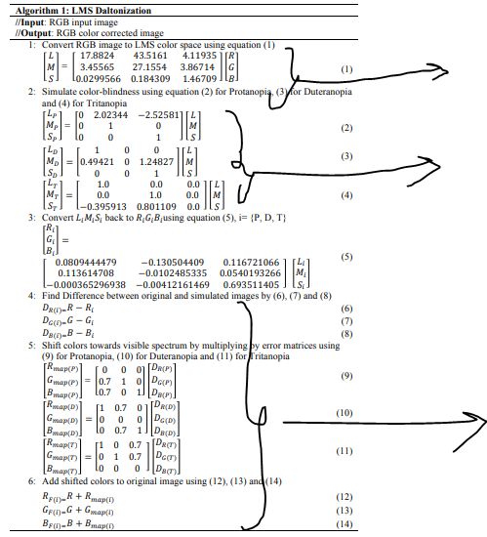
Daltonization.py file functions
tolms function
3 different functions named (ConvertToProtonapes , ConvetToDeuteronapes, ConvertToTritonope)
Shifting of colors (Assuming that user has high level of corresponding type of colorblindness).
This assumption makes this algorithm inefficient.
daltonize function

